Slide 1
K.HASAN BASARIA
ASSISTANT PROFESSOR
DEPARTMENT OF ENGLISH
JAMAL MOHAMED COLLEGE
TRICHY -20

Slide 2
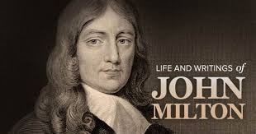
• John Milton was born in Bread Street, London on 9th December, 1608. He was the one and only epic poet in English. He was a strong supporter of the Puritan Government. Milton retired from active politics and concentrated on his writing.
Notes:
.

Slide 3
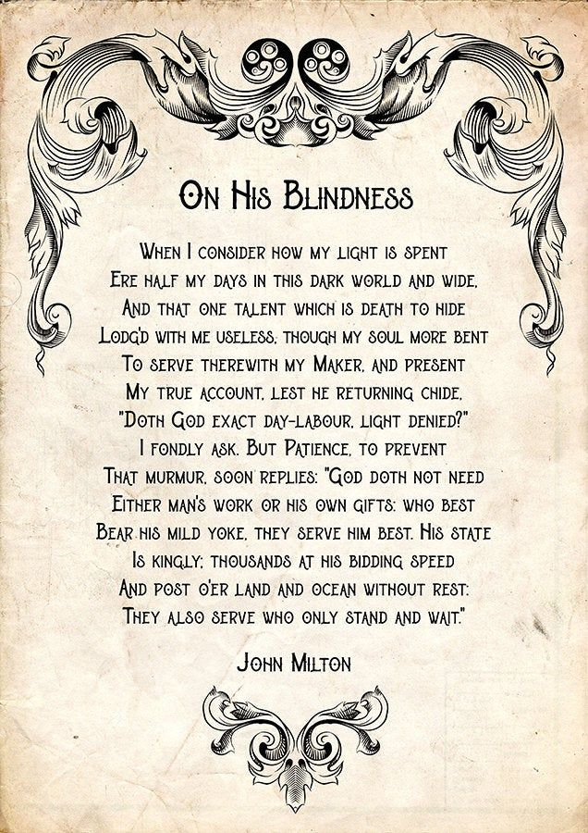
In this sonnet On His Blindness (1673) the poet laments, because of his blindness. The Petrachan sonnet form is followed by Milton. The first eight lines is called ‘the octave’.
The next six lines is called “sestet. In Milton’s sonnet, the octave contains his complaints against God and the sestet records his eventual reconciliation with God.

Slide 4
……one talent which is death to hide
Lodg'd with me useless …….
In this poem the poet asks how God can expect him use his ‘poetic talent’ as a writer , when he was blind.he must not bury his talent, because on Christ’s return to earth he wants to know how everyman has invested his talent.
…… though my soul more bent
To serve therewith my maker, and present
My true account , test he returning chide
Milton’s writing an epic was not only an intellectual task, but also involving hard spiritual effort. He believed that a great poet was religious. The poet is afraid that he will be scolded by his Master namely, God for not using his gifts (Poetic talent) and writing immortal poems.

Slide 5
‘Doth God exact day – labour, light denied?
The word ‘day – labour’ is an allusion in this passage to the Biblical parable of labourer. The labourers who have worked for a longer time grimble because they are not paid proportinately higher wages. In the same way Milton feel better thinking that though he has also to work hard. There is an implication that God is cruel and has deliberately made him blind.
Notes:
Biblical Parable in the sonnet On His Blindness ‘
Doth God exact day labour

Slide 6
Poet’s Reconciliation with God
Milton replies that ,
God doth not need,
Either man’s work or his own gifts.
In the last six lines, the poet recollects that God not need men to work for him, Those who accept and endure hard ships patiently serve him . Those who accept and endure hard ships patiently serve him as well as those who rush about the world in his service.

Slide 7
Biblical Comparison of Blindness to Yoke:
…….. Who best
Bear his mild yoke, they serve him best…
Yoke is the wooden pole placed across the neck of an ox pulling a cart. The carter
Imposes on the animal only the difficulty that he can endure viewed in his light, the blindness inflicted on Milton is only a mild yoke.
‘……. His state
Is kingly: thousands at his bidding speed.’
The poet uses the well-known practice of comparing God to a great king. This is allusion to the prophecy of Daniel in which Danial speaks of thousands of followers waiting of God.

Slide 8
‘They also serve who only stand and wait’
The poet uses another Biblical comparison of men to angels. The thousands of angels who meekly waited on God’s bidding. They are not to be dismissed as idle. Finally, the Milton understood that God only serve to men ,but does not expect to be served by men.

Slide 9
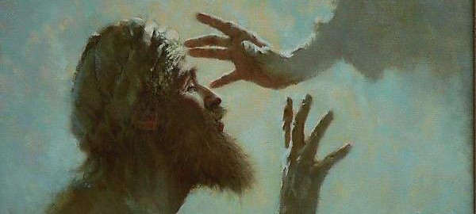
Conclusion:
By the end of the poem he comes to believe that God does not ‘expect to be served by men and that those who wait on God silent and patiently also serve Him (God) in their own small way.

